Slide 1
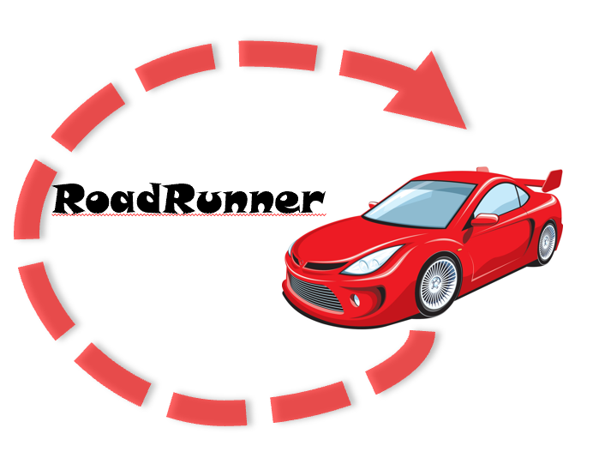
RoadRunner
PSYCH 734: Usability Testing and Product Design
Presented By:
Chelsea Young
Molly Kluck
Liam Kettle
April 26, 2021
Notes:
Chelsea

Slide 2



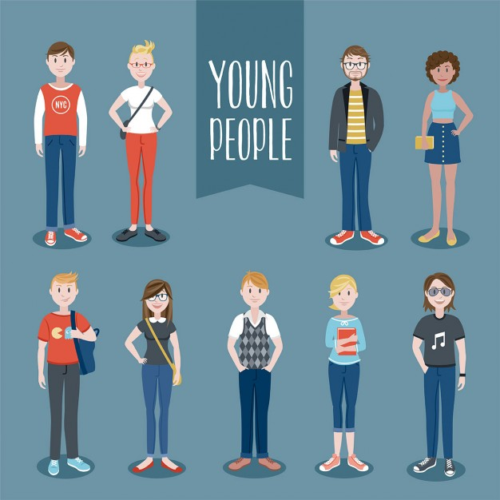

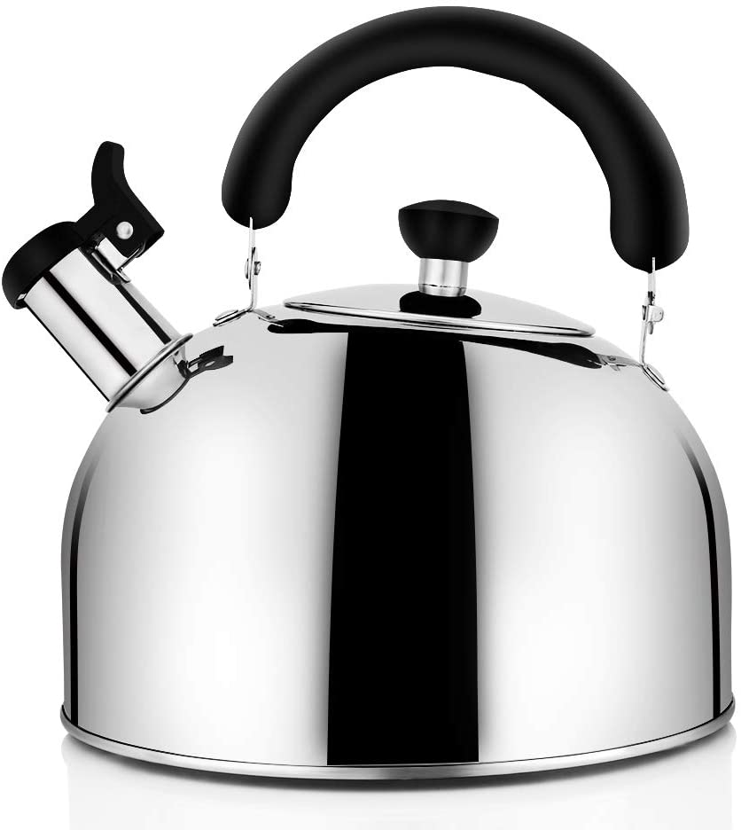
Meeting Team Young Lucky Kettles
Chelsea Young
First-year Master’s student in the Human Factors and Applied Cognition program at George Mason University
Molly Kluck
First-year Master’s student in the Human Factors and Applied Cognition program at George Mason University
Liam Kettle
First-year PhD student in the Human Factors and Applied Cognition program at George Mason University
Notes:
Chelsea
Molly
Liam

Slide 3



Presentation Agenda
Methods
Personas
Task Analysis
Competitor Analysis
Context Analysis
Heuristic Evaluation
Recommendations
Prototype
Future Steps
Q&A
Notes:
Liam → Pass to Molly afterwards
Intro and agenda slides - .5 minutes (all)
Personas - 3 minutes (Molly)
Task analysis - 1 minute - Molly
Competitor analysis - 1.5 minutes (Chelsea)
Context analysis - 1.5 minutes (Chelsea)
Heuristic eval - 2 minutes (Liam)
Recommendations - 2 minutes (Chelsea/Molly)
Prototype - 4 minutes (Liam)
Future Steps - 1.5 minutes (Liam/Chelsea/Molly)

Slide 4
Methods
Notes:
Molly

Slide 5
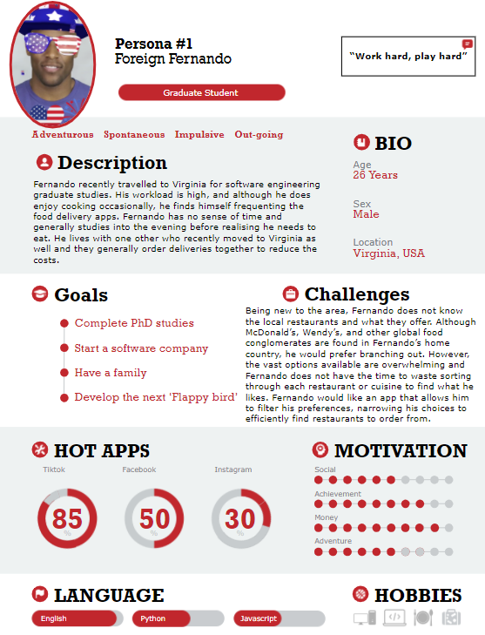
Personas
Personas are marketing and usability techniques where a “personality” is created for the use of a product designer to base their product design off of. This helps product designers get in the shoes of their users.
Notes:
Molly (Persona of interest)
International graduate student
New to the area; unfamiliar to local restaurants
Prefers filtering restaurants to eliminate undesired cuisines

Slide 6
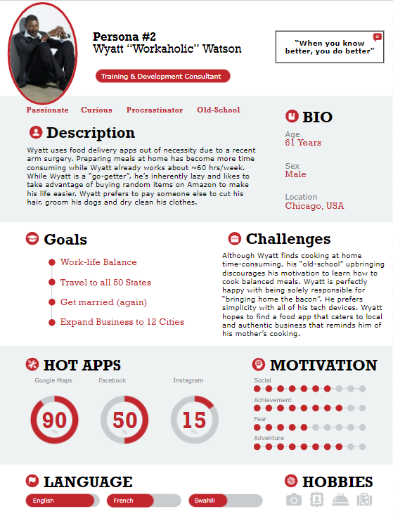
Personas
Personas are marketing and usability techniques where a “personality” is created for the use of a product designer to base their product design off of. This helps product designers get in the shoes of their users.
Notes:
Molly
Name, Career, Bio,
Fast and authentic experience to match his fast-paced lifestyle
Prefers simplicity as an old-timer (recently learned google maps)

Slide 7
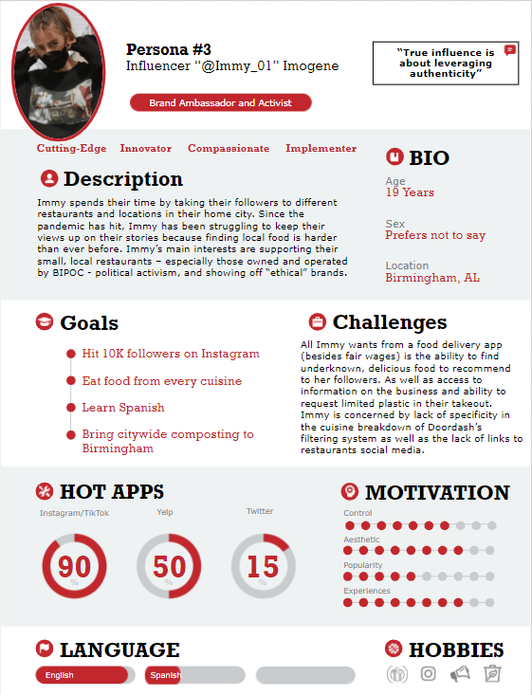
Personas
Personas are marketing and usability techniques where a “personality” is created for the use of a product designer to base their product design off of. This helps product designers get in the shoes of their users.

Slide 8
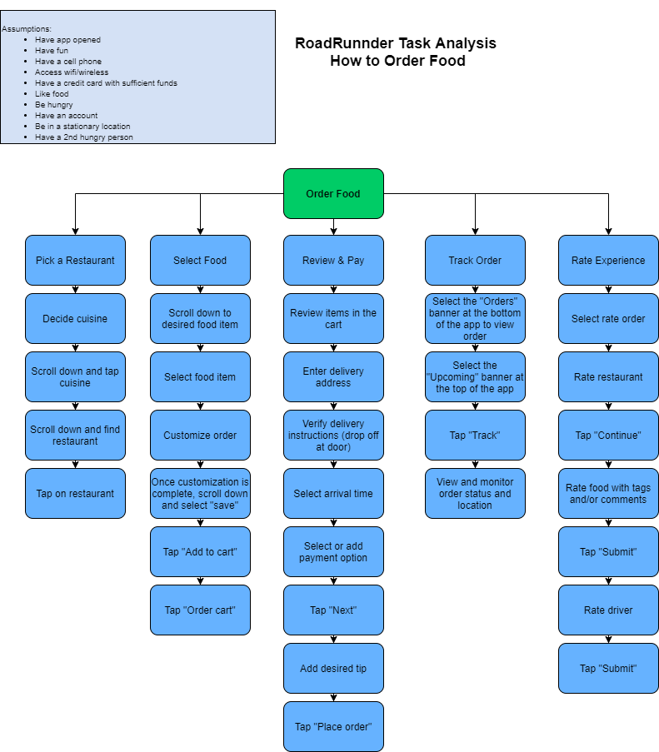
Graphical Task Analysis for ordering food in RoadRunner
Assumptions:
Have app opened
Have fun
Have a cell phone
Access wifi/wireless
Have a credit card with sufficient funds
Like Food
Be hungry
Have an account
Be in a stationary location
Have a 2nd hungry person
Notes:
-Molly

Slide 9
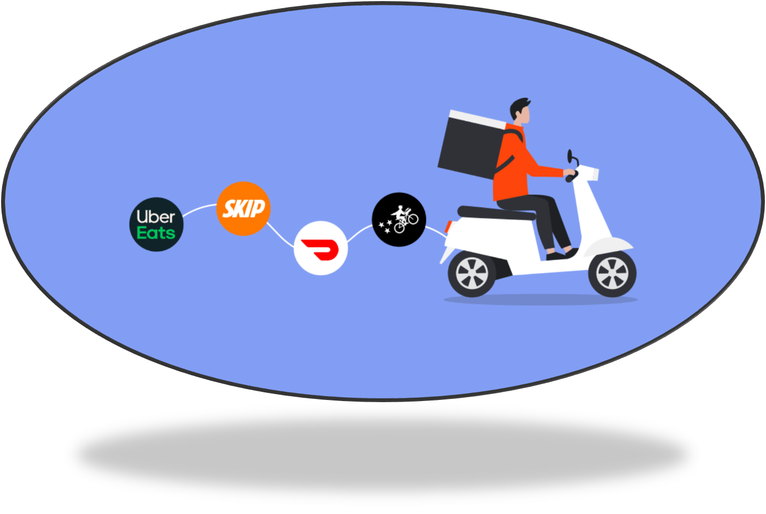
Competitor Analysis
Understand and capitalize on competitor strengths (and weaknesses) to enhance our personal application strategy
Notes:
Chelsea
Over the course of the next few slides, I am going to discuss our competitor analysis results while focusing on five main tasks.

Slide 10
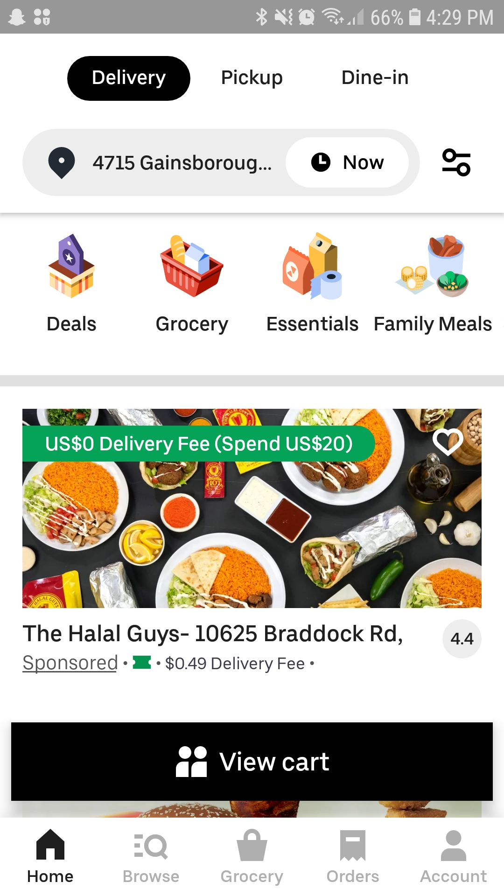
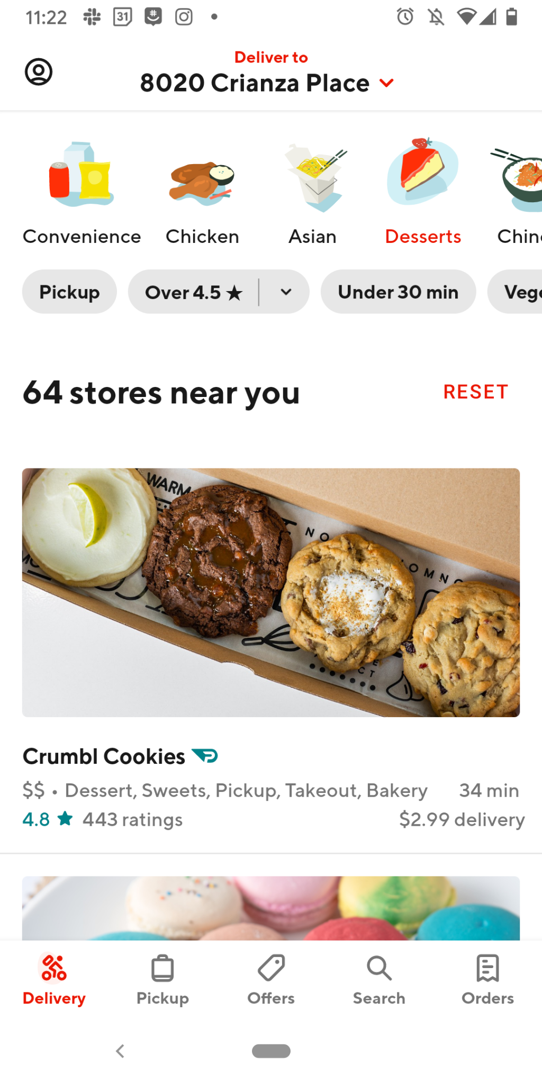
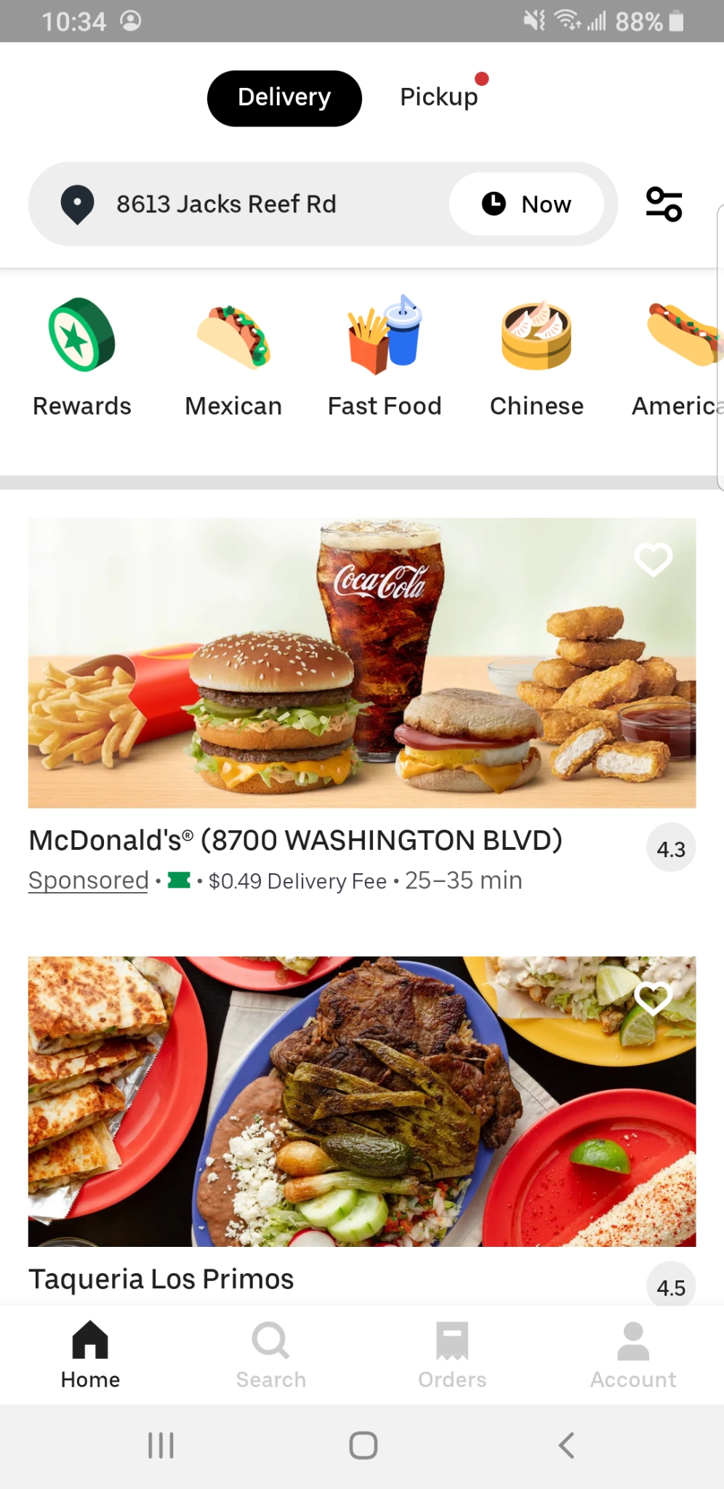


Task 1: Filtering and Searching
Notes:
Chelsea
Our focus was to identify which apps allowed flexible filtering and searching options...specifically with the goal of highlighting non-chain restaurants
Grubhub - filters aren’t co-located
Doordash - limited to cuisines and doesn’t break down “Asian” very well
Uber Eats - simplistic scroll feature with search engine that matches how most users search for desired restaurant...however, still did not capture unique restaurants

Slide 11
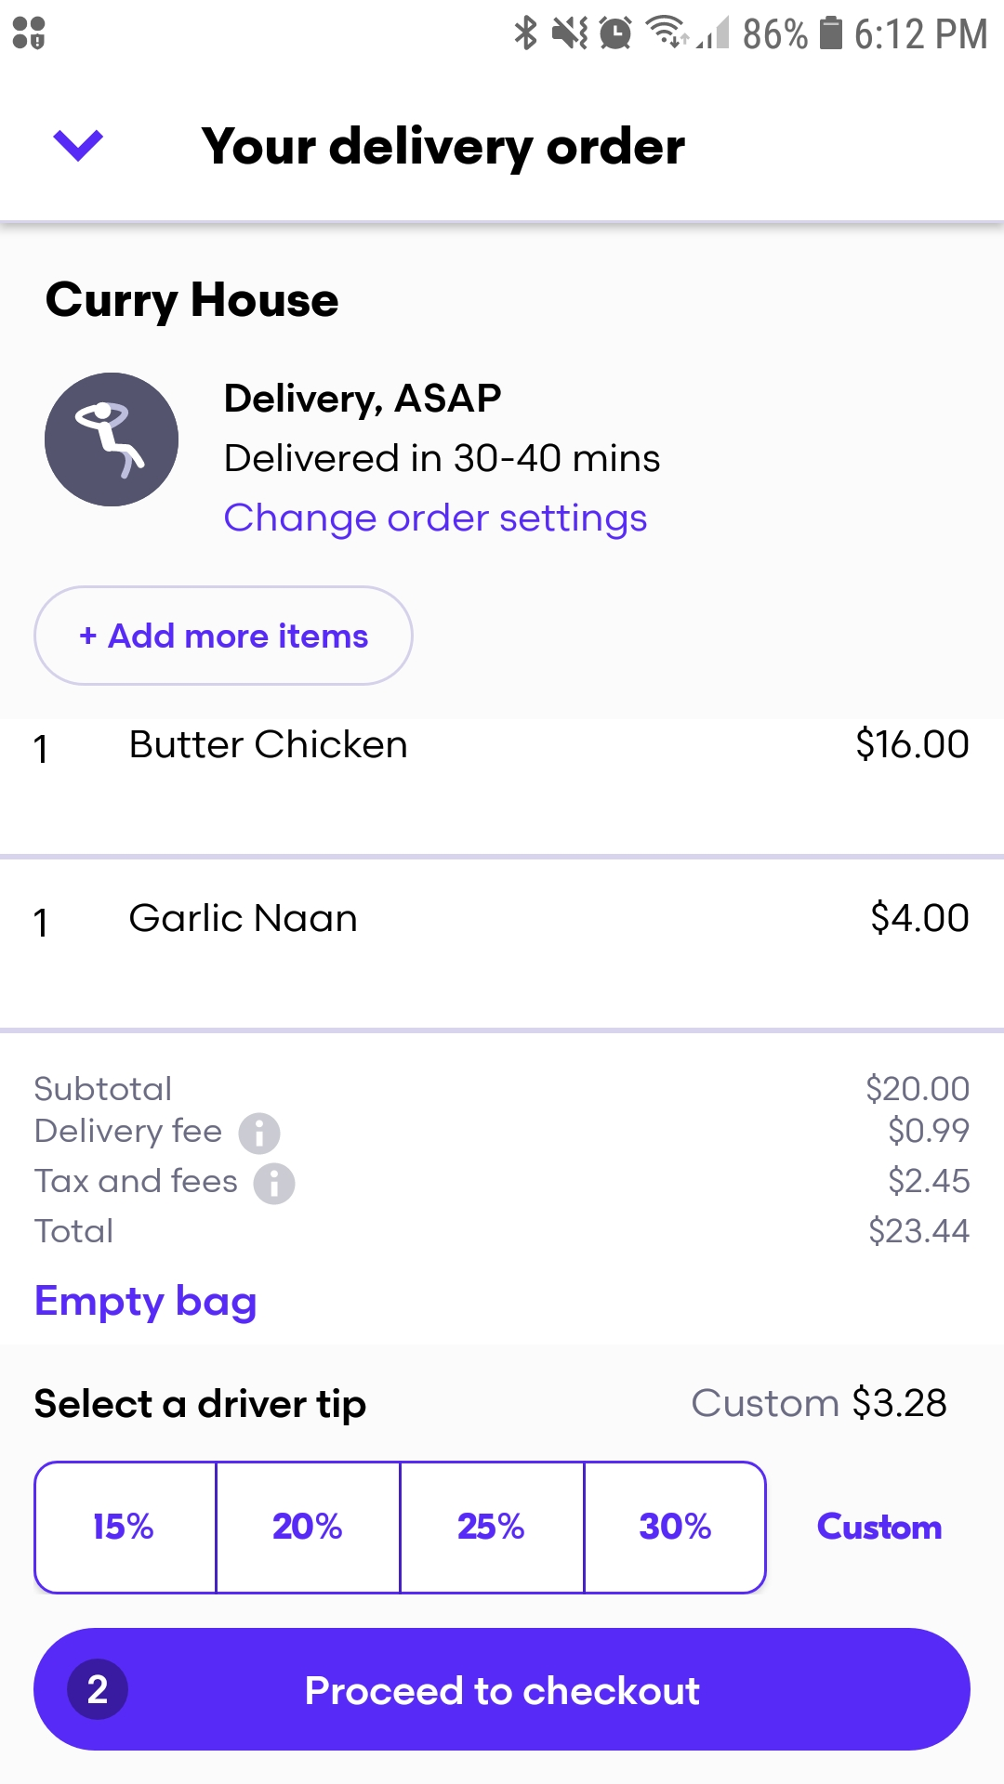
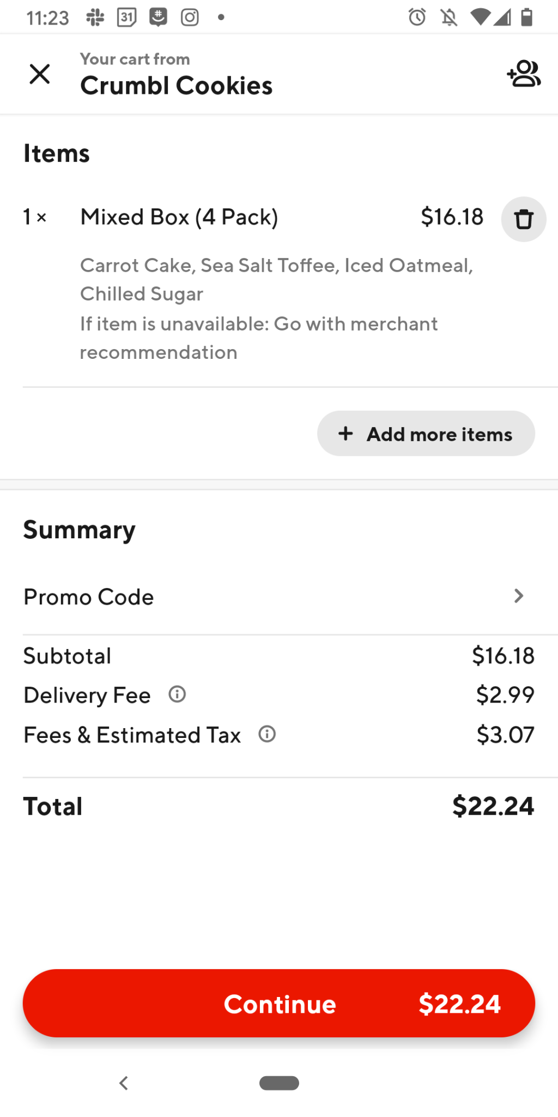
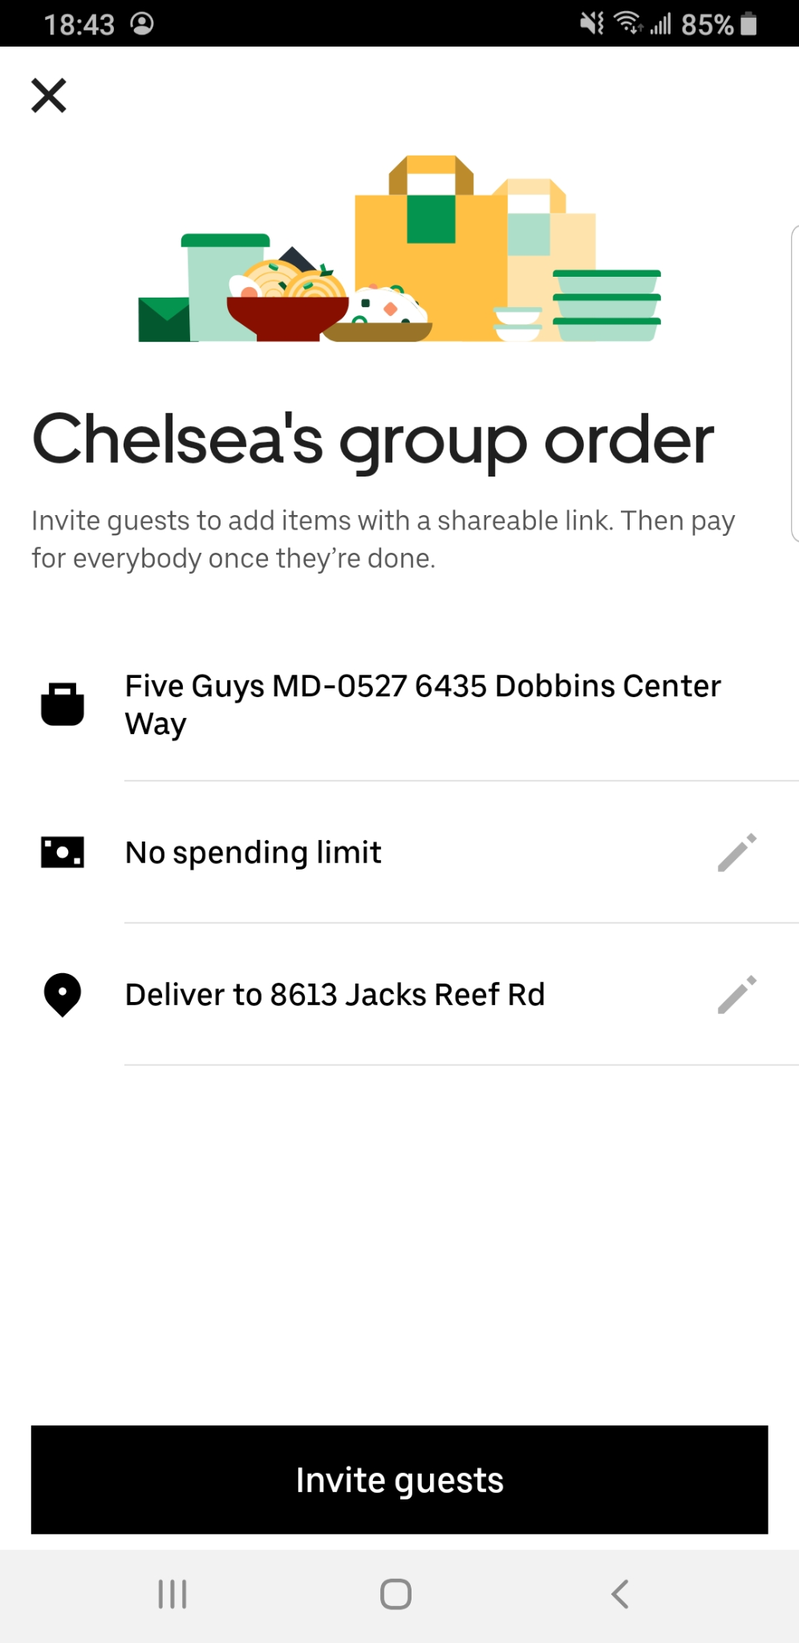
Task 2: Payment and Processing
Notes:
Chelsea
Efficient processes for group orders includes the ability to split payments between group members

Slide 12
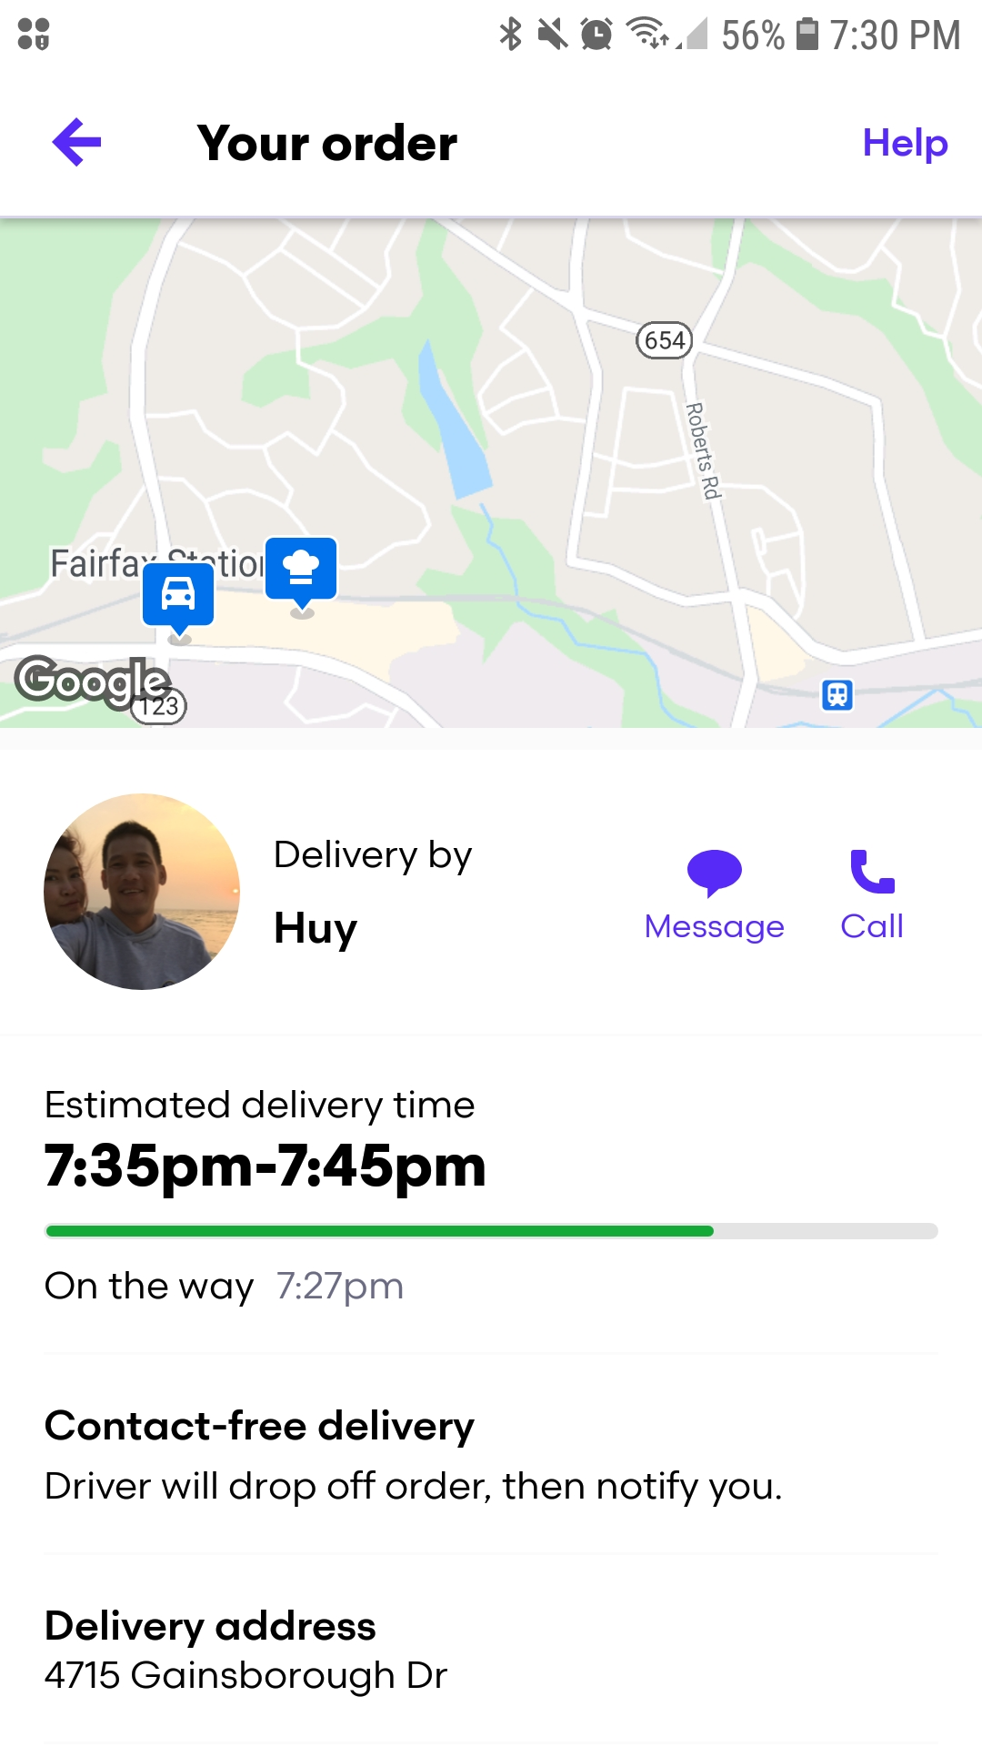
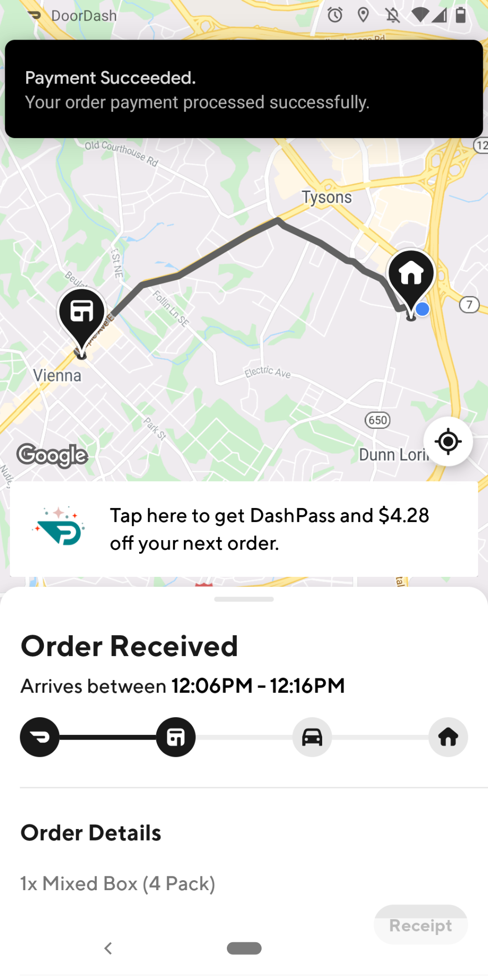
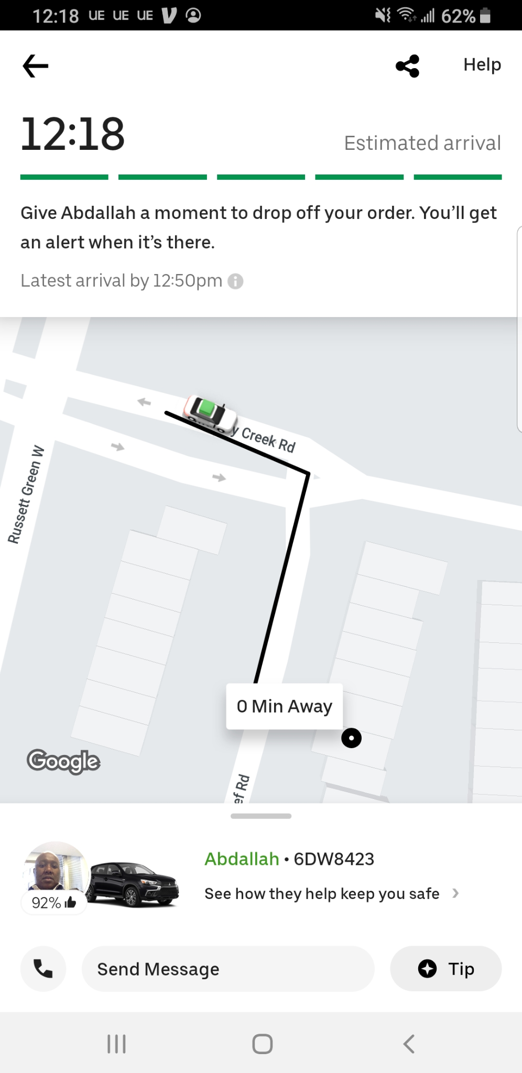
Task 3: Order Tracking
Notes:
Chelsea
All three apps tracked orders from order completion to arrival in a sufficient manner
Our aim is to remain consistent with this design for our prototype

Slide 13
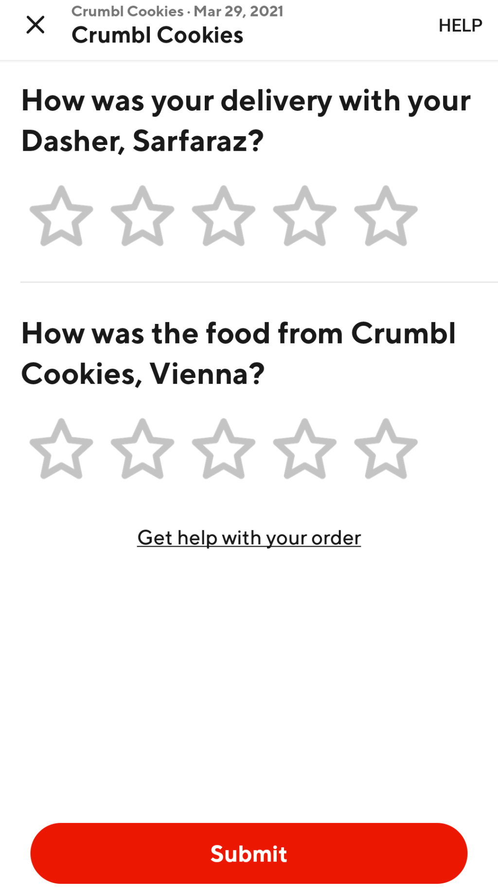
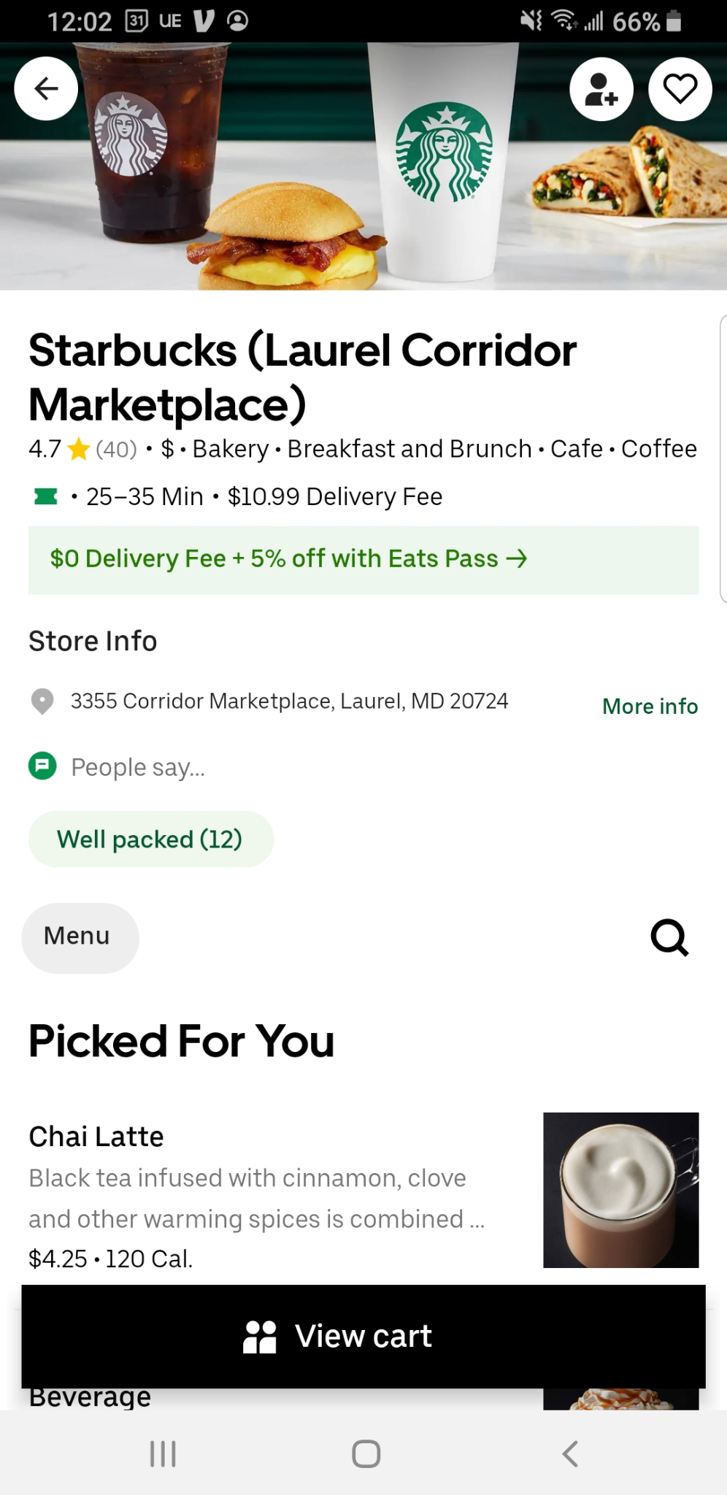
Task 4: Rating and Reviews
Notes:
Chelsea
Ratings and reviews are critical to enhance user experience. We specifically looked at whether or not these apps illustrated both ratings and written reviews
Grubhub - Can read reviews but not filter by ratings
Doordash - can filter by ratings but can’t read reviews
Uber Eats - rating numbers present but no visible written reviews (can’t filter)

Slide 14
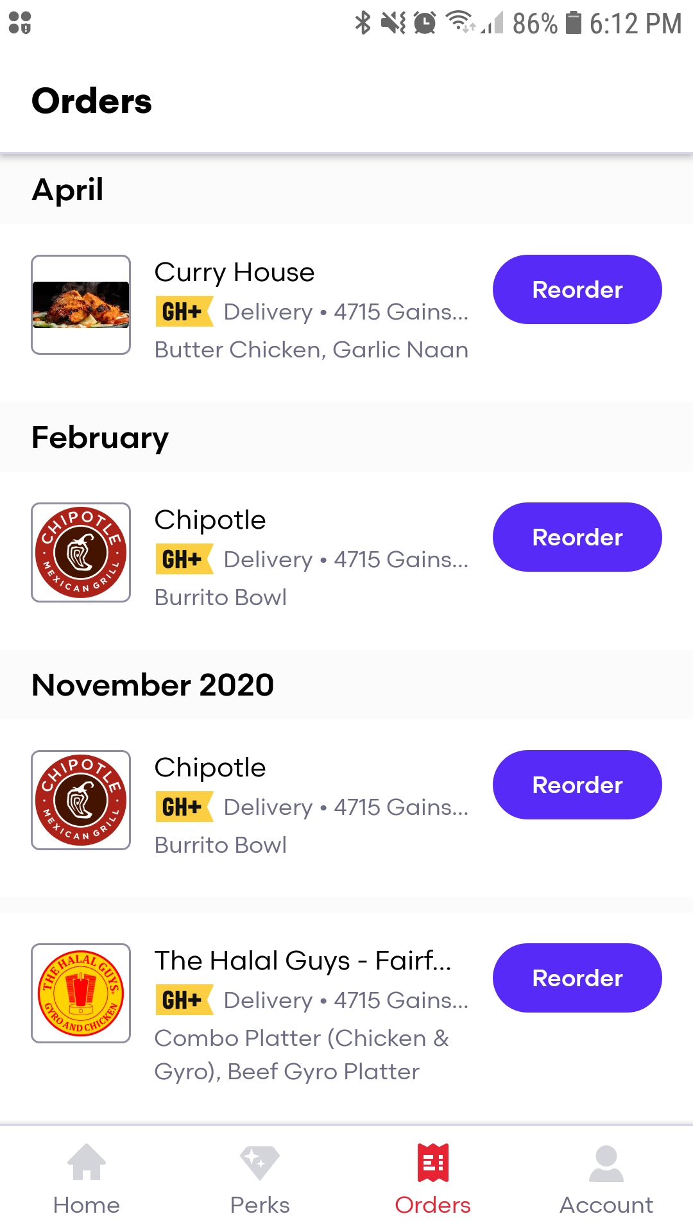
Task 5: Re-ordering
Notes:
Chelsea
The ability to re-order food increases the frequency of positive experiences and advertisement (friends can quickly recall and share with other friends)
Both Grubhub and UberEats captured this feature fairly well while doordash did not

Slide 15
Competitor Analysis
App | Filtering / Searching | Payment / Processing | Order Tracking | Rating / Reviews | Re-ordering
Notes:
Chelsea
Key takeaways and focus areas include capitalizing on the efficient order tracking process while improving the processes and overall experience for finding a restaurant, reviewing and payment, group orders and ratings and reviews.
Transition to Context Analysis

Slide 16

Context Analysis
To examine the technical and physical environments for all stakeholders and ensure recommendations align with identified capabilities and limitations
Notes:
Chelsea

Slide 17
Context Analysis:
Description & Purpose | Food delivery experience that specializes in seamless processes from choosing a restaurant to splitting group payments Introduce users to unique, or non-chain restaurants with efficient access to filter options and ratings/reviews
Main Application Areas | Reinvigorate user experience with local restaurants Optimize user experience with efficient access to rating and reviews Expand group order opportunities
Notes:
Chelsea

Slide 18

Context Analysis:
Delivery Driver
Main Goals
To receive a food delivery order
To navigate a delivery order
Food Consumer
Main Goals
To filter restaurants using multiple characteristics
To place an individual order
To place a group order
To view food status
To view food location
To view reviews and ratings
To rate delivery drivers
Restaurant
Main Goals
To receive a food order
To accept a food order
To alert driver and customer of food status
Notes:
Chelsea
Transition to Liam for Heuristic Evaluation

Slide 19
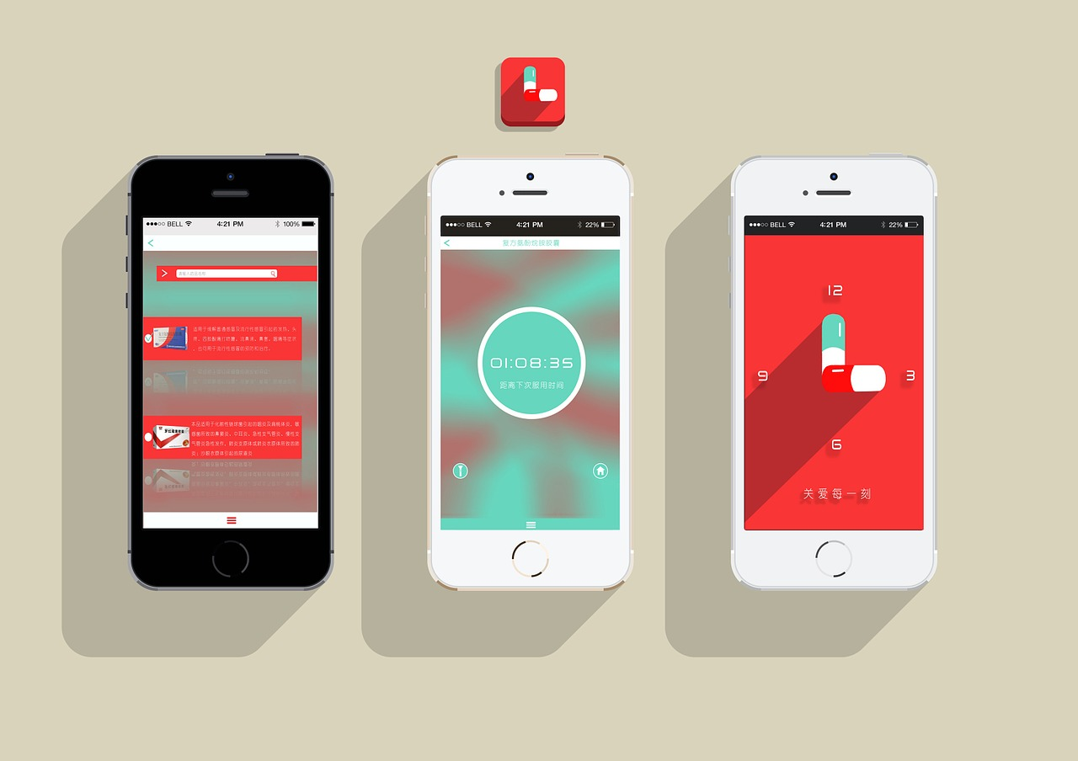
Heuristic Evaluation
To evaluate the different app interfaces using recognized usability principles and provide insights for usability recommendations
Notes:
Liam

Slide 20
Heuristic Evaluation - Nielsen’s 10 Heuristics
01
Visibility of System Status
06
Recognition Rather Than Recall
02
Match between System
and the Real World
07
Flexibility and Efficiency of Use
03
User Control and Freedom
08
Aesthetic and Minimalist Design
04
Consistency and Standards
09
Recognize, Diagnose, and
Recover from Errors
05
Error Prevention
10
Help and Documentation
Notes:
Liam

Slide 21
Heuristic Evaluation - Task 1: Pick a restaurant
App | Component | Heuristic(s) Violated | Severity
 | Finding a restaurant | 4. Consistency and Standards, 8. Aesthetic and Minimalist Design | 2
 | Finding a restaurant | 2. Match Between System and Real World 7. Flexibility and Efficiency of Use 8. Aesthetic and Minimalist Design | 3
 | Finding a restaurant | --- | 0
Notes:
Liam

Slide 22
Heuristic Evaluation - Task 2: Select food
App | Component | Heuristic(s) Violated | Severity
 | Selecting Food | 2. Match Between System and Real World 7. Flexibility and Efficiency of Use 8. Aesthetic and Minimalist Design | 2
 | Customizing Food | 8. Aesthetic and Minimalist Design | 2
 | Selecting Food | 7. Flexibility and Efficiency of Use | 2
 | Customizing Food | ---- | 0
 | Selecting Food | ---- | 0
 | Customizing Food | 8. Aesthetic and Minimalist Design | 2
Notes:
Liam

Slide 23
Heuristic Evaluation - Task 3: Reviewing and paying
App | Component | Heuristic(s) Violated | Severity
 | Reviewing | 3. User Control and Freedom | 1
 | Paying | 4. Consistency and Standards 6. Recognition Instead of Recall 7. Flexibility and Efficiency of Use 8. Aesthetic and Minimalist Design | 2
 | Reviewing | 8. Aesthetic and Minimalist Design | 1
 | Paying | 4. Consistency and Standards | 2
 | Reviewing | ---- | 0
 | Paying | 8. Aesthetic and Minimalist Design | 2
Notes:
Liam

Slide 24
Heuristic Evaluation - Task 5: Rating
App | Component | Heuristic(s) Violated | Severity
 | Rating | No option provided | 4
 | Rating | 4. Consistency and Standards 5. Error Prevention | 2
 | Rating | 4. Consistency and Standards | 1
Notes:
Liam

Slide 25
Heuristic Evaluation Summary
App | Total # of Heuristics Violated | Average Severity
 | 11 | 2.17
 | 8 | 1.67
 | 3 | 0.83
Grubhub had highest usability violations
Lack of a functional rating system
Uber Eats outperformed its competitors
No usability issues were found with tracking food; no need to prototype
Aesthetic and Design most common violation; followed by Consistency & Standards, Flexibility & Efficiency of Use
Notes:
Liam
Pass it back to Molly for recommendations

Slide 26

Recommendations
Notes:
Molly

Slide 27
RoadRunner - Recommendations
Task | Recommendations
Picking a Restaurant | Consistent navigation controls and accessible multi-filter options Customizable home screen
Selecting Food | Flexible and multi-search options to present restaurants by major food groups Efficient navigation features that guide users back to previous step
Reviewing and Paying | Aesthetic and minimalist design with scroll feature to view entire order Efficient group order process that matches familiar social media practices
Rating Food and Service | Consistent and concise design to review food and service
Notes:
Molly and then Chelsea
While integrating our personas and analyzing our results, we developed the top four tasks for our prototype.
Transition to Liam

Slide 28
RoadRunner
Notes:
Liam

Slide 29
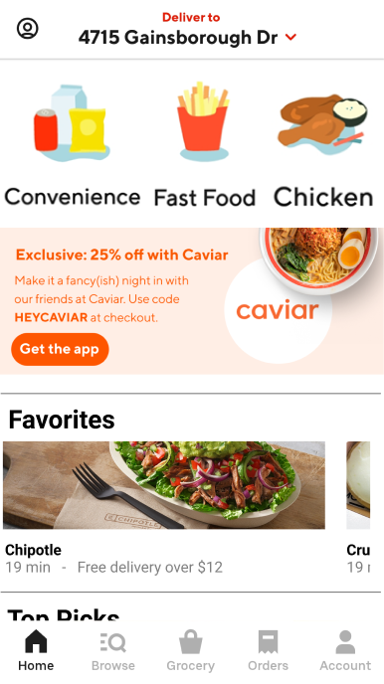
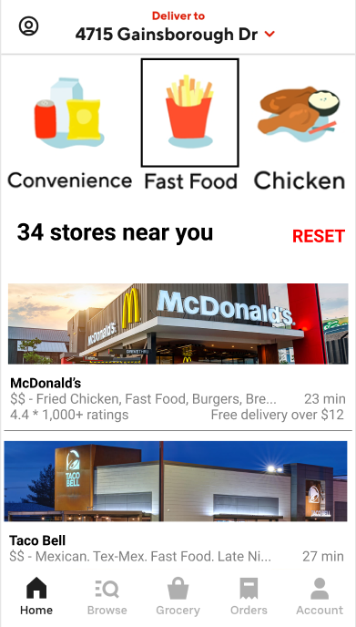
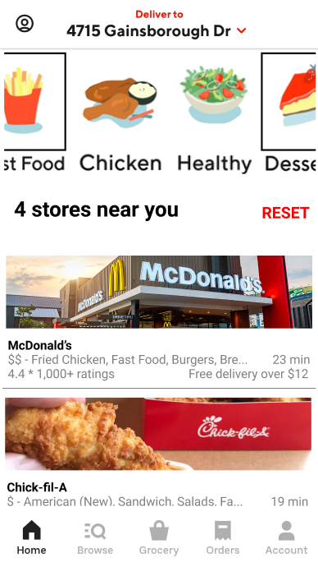
RoadRunner
Notes:
Slider at the top allows for multiple selection. Tapping additional categories (i.e., fig 3) filters the restaurants

Slide 30
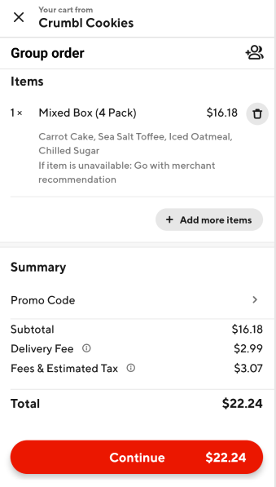
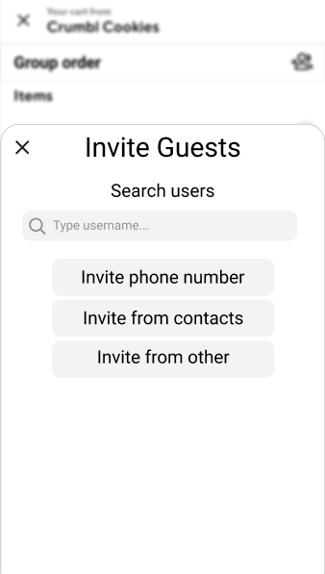
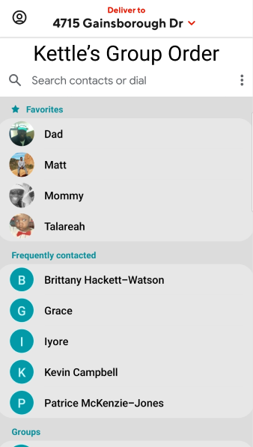
RoadRunner
Notes:
Group order payment and inviting guests. After tapping “Invite from contacts” → Invite guests tap slides up as an overlay feature
Has a search users function for adding in the “uber friends” functionality

Slide 31
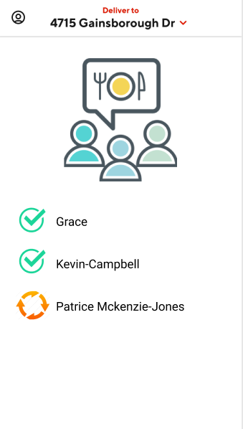
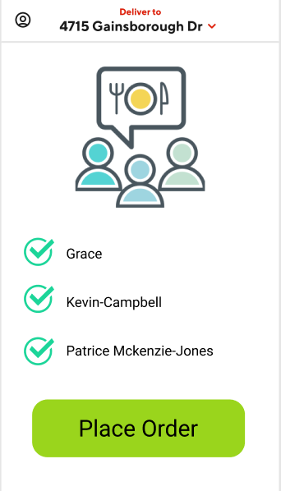
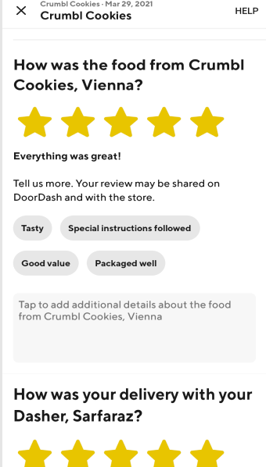
RoadRunner
Notes:
View of group payments
View of rating food after delivery. Scrollable and only able to submit at the bottom (or exit using the x at the top)

Slide 32
Future Steps
Notes:
Liam

Slide 33

Friend system
Notes:
LIAM
→ Pass to Chelsea

Slide 34
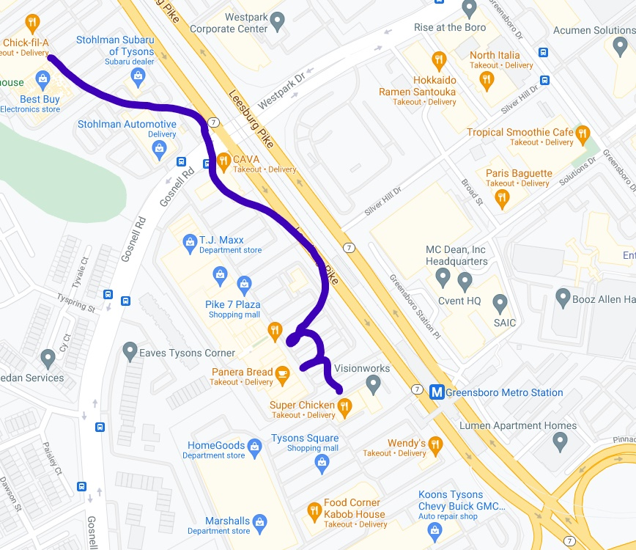
Ordering from different restaurants in the same area
(close-proximity restaurant ordering)
Notes:
CHELSEA

Slide 35
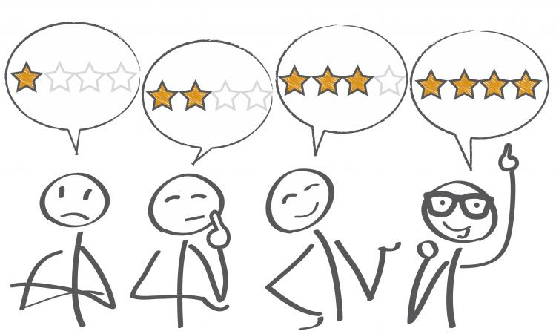
Being able to filter restaurants based on review tags.
Notes:
MOLLY

Slide 36
Questions?

